Slide 1

PRESENTATION
Computer Vision & Machine Learning
Neural Network Models for
Object Recognition
Classical ML Approaches for CIFAR-10
Track 1
Feature Engineering + SVM/KNN
Presented by
Machine Learning Module
2025

Slide 2
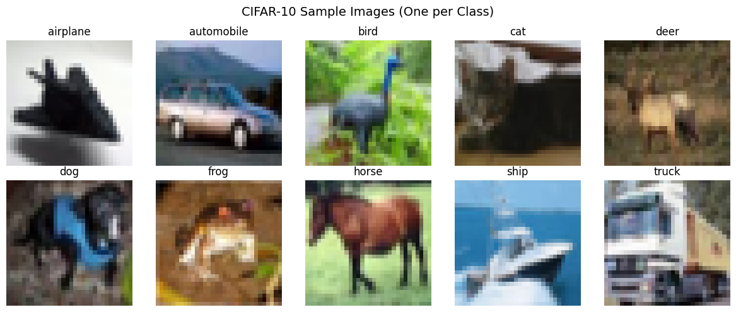
DATASET OVERVIEW
Object Recognition Challenge: CIFAR-10
Total Images
Classes
CIFAR-10 Sample Images
60,000
10
Color images (32×32 pixels)
Balanced (6,000 each)
Why It's Challenging
Low resolution: Human observers struggle at 32×32 pixels
Intra-class variation: Same class in different poses (e.g., cats)
Inter-class similarity: Difficult to distinguish (e.g., cats vs. dogs)
10 Classes:
airplane
automobile
bird
cat
deer
dog
frog
horse
ship
truck
One representative image per class (32×32 pixels)

Slide 3
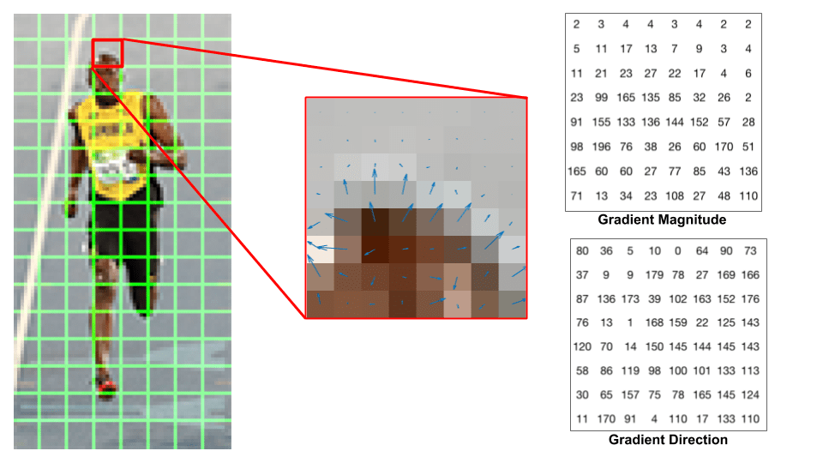
METHODOLOGY
Track 1: Classical ML with Feature Engineering
HOG
Selected Approach
Histogram of Oriented Gradients
Captures edge orientations & shape information
HOG + SVM
Identifies object boundaries and contours
Feature extraction + Classification
Robust to illumination changes
Focuses on gradient directions, not absolute pixel values
Optimal balance of accuracy & efficiency
9.48× dimensionality reduction
3,072 pixels → 324 HOG features
HOG Feature Visualization
SVM
Support Vector Machine
Excels in high-dimensional spaces
Effective with 324-dimensional HOG features
Maximum margin = better generalization
Gradient magnitude and orientation extraction
Finds optimal decision boundary
Kernel trick handles non-linearity
RBF kernel maps to higher dimensions
Baseline: KNN
Instance-based classifier for comparison. Simple but computationally expensive at inference time.

Slide 4
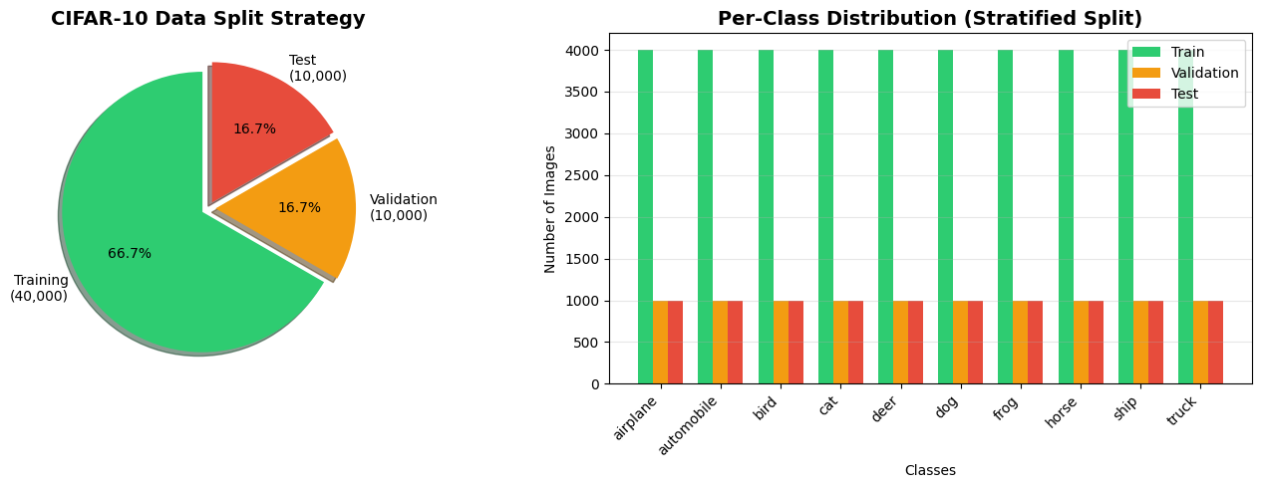
DATA STRATEGY
Dataset Split Strategy
Data Distribution
Stratified Split Visualization
40,000
10,000
10,000
Training
Validation
Test
80%
20%
Held Out
Why Validation Matters
1
Hyperparameter tuning without data leakage
Prevents overfitting to test set
2
Model selection (SVM vs. KNN)
Compare performance on unseen data
3
Early stopping detection
Monitor for convergence
4
Unbiased test set for final evaluation only
Used ONCE at final evaluation

Slide 5
PIPELINE
Track 1 Feature Engineering Pipeline
1
Raw Image
3,072
32×32×3 = 3,072 pixels (RGB)
dimensions
2
Grayscale Conversion
1,024
Remove color dependency
dimensions
3
HOG Feature Extraction
324
9 orientations • 8×8 cells • 2×2 blocks
features
Dimensionality Reduction
4
StandardScaler
324
3,072
324
Zero mean, unit variance normalization
features
Raw pixels
HOG features
9.48×
5
RBF SVM Classification
10
Compression ratio
10-class multi-class prediction
classes

Slide 6
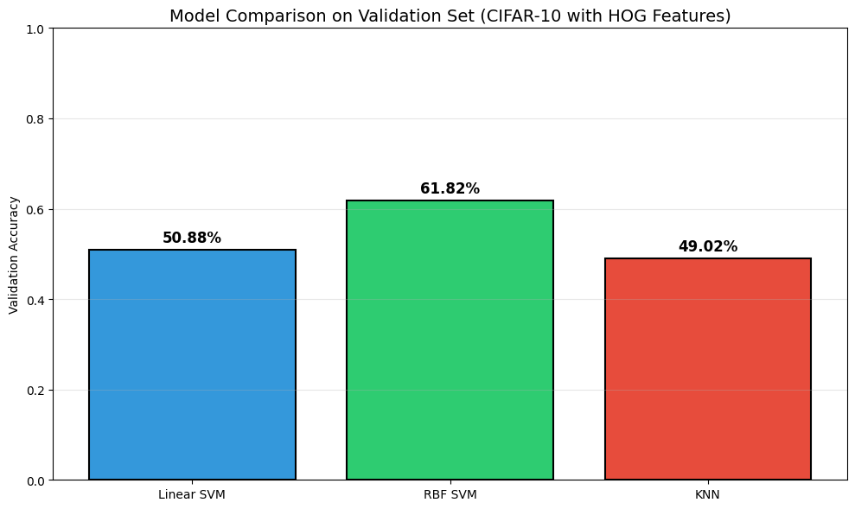
MODEL SELECTION
Validation Set Performance Comparison
Model Performance on Validation Set
Performance Summary
KNN (k=9)
49.02%
Instance-based, slow inference
~0 sec training
Linear SVM
50.88%
Fast, limited by linear boundary
71 sec training
RBF SVM
61.82%
Non-linear, best performance
~16 min training
Winner: RBF SVM
+10.94 pp over Linear SVM
+12.8 pp over KNN
HOG features + Different classifiers
Justifies increased training time

Slide 7
OPTIMIZATION
Hyperparameter Optimization
GridSearchCV
Why These Work
3-fold cross-validation
Higher C = Complex Boundaries
C
Allows model to fit training data more closely, reducing bias
C (Regularization)
Gamma (Kernel)
0.1
1
10 ✓
scale
auto ✓
0.001
0.01
γ
Auto Gamma = Adaptive
Scales automatically with feature dimensions (1/n_features)
Controls margin width
Kernel coefficient
3-Fold CV = Balance
3×
Balances speed and reliability for hyperparameter search
Best Configuration
Computational Cost
C Value
Gamma
10
auto
Parameter combinations
12
Lower regularization
Adaptive scaling
Cross-validation folds
3
Total fits
36
Cross-validation accuracy
55.60%
Total search time
~45 min

Slide 8
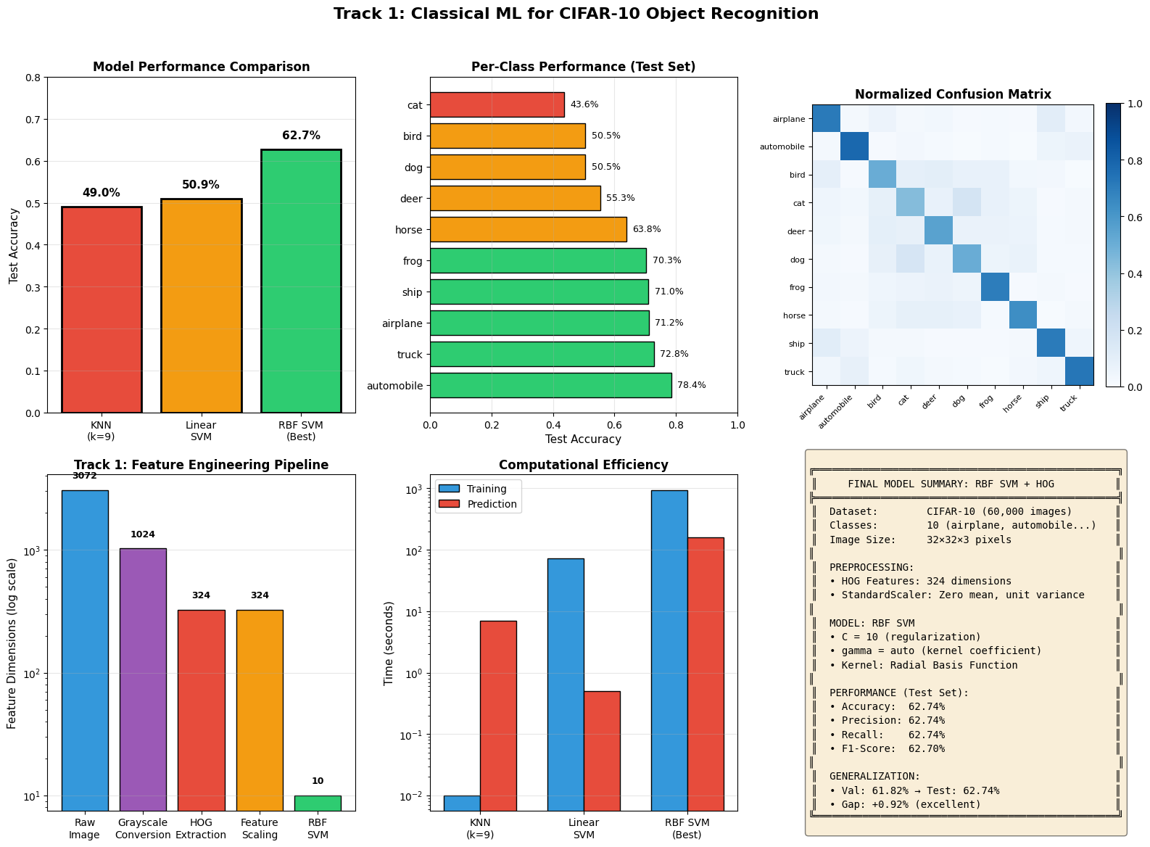
RESULTS
Final Test Set Performance: RBF SVM
Overall Metrics
Complete Results Dashboard
Accuracy
Precision
62.74%
62.74%
Recall
F1-Score
62.74%
62.70%
Per-Class Performance
Best: Automobile
78.4%
Truck
72.8%
Airplane
71.2%
Generalization Gap
Challenging: Cat
43.6%
61.82%
62.74%
Bird
50.5%
Validation
Test
Gap: +0.92% (Test > Validation)
Dog
50.5%
No overfitting → Robust model

Slide 9
DEMO
Live Model Demonstration
Example 1
Example 2
Example 3
Automobile
Frog
Cat
Correct ✓
Correct ✓
Incorrect ✗
Predicted:
automobile
Predicted:
frog
Predicted:
dog
Decision Score:
2.45
Decision Score:
1.89
Decision Score:
0.76
True:
automobile
True:
frog
True:
cat
2nd guess:
cat (0.54)
Clear shape features make this an easy prediction
Distinctive contour patterns recognized successfully
Low confidence indicates uncertainty between similar classes
Inference Performance
Why the Cat Failed
Texture vs. Shape: HOG captures edges, not fur patterns
~16ms
~62
Similar silhouettes: Cats and dogs share body shapes
Per image
Images/sec
Low resolution: 32×32 loses fine distinguishing features

Slide 10
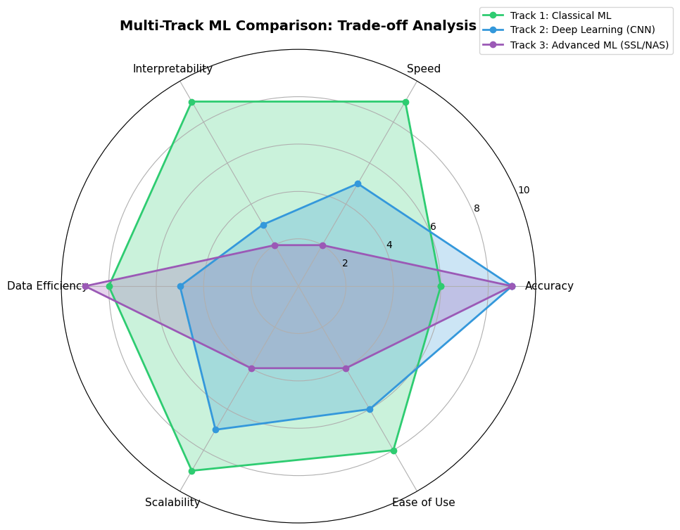
COMPARISON
Track Comparison: Trade-off Analysis
Multi-Dimensional Comparison
Detailed Comparison
Metric
Track 1
Track 2
Track 3
Accuracy
63%
90-95%
90-95%
Training Time
15 min
2-4 hrs
10+ hrs
Hardware
CPU
GPU
GPU cluster
Interpretability
High
Low
Very Low
Data Efficiency
High
Moderate
High (SSL)
Ease of Use
High
Moderate
Low
Track 1 Wins
Trade-off
✓ Speed
Lower accuracy for efficiency & interpretability
✓ Interpretability
6-dimensional performance comparison across ML approaches
✓ Simplicity

Slide 11
ANALYSIS
Strengths & Limitations
What Worked
What Challenged Us
Efficient Training
Accuracy Ceiling
15 minutes vs. hours for CNNs
~63% vs. 90%+ for deep learning
Manual Feature Engineering
Interpretable
Requires domain knowledge
HOG features show what model "sees"
Texture-Based Classes
No GPU Required
Struggles with cats, birds (texture-heavy)
Runs on standard hardware
Low Resolution Limitation
32×32 loses fine details
Data Efficient
Works well with 40K samples
No Data Scaling
Performance doesn't improve with more data
Excellent Generalization
No overfitting detected
Root Cause
HOG captures shape, not texture

Slide 12

CONCLUSION
Conclusions & Key Learnings
Key Achievements
Future Improvements
62.74% accuracy on CIFAR-10 using classical ML
Feature Combination
Robust validation strategy with no overfitting
HOG + color histograms + LBP features
Successful hyperparameter optimization
Ensemble Methods
Comprehensive comparative analysis
SVM + Random Forest combination
For Production
Key Learnings
Track 2 (CNN) recommended for higher accuracy
1
Feature engineering compensates for algorithmic simplicity
2
Validation strategy is crucial for unbiased evaluation
3
All ML approaches involve trade-offs
Thank You
4
Classical ML remains viable for resource-constrained scenarios
Questions & Discussion

